Slide 1
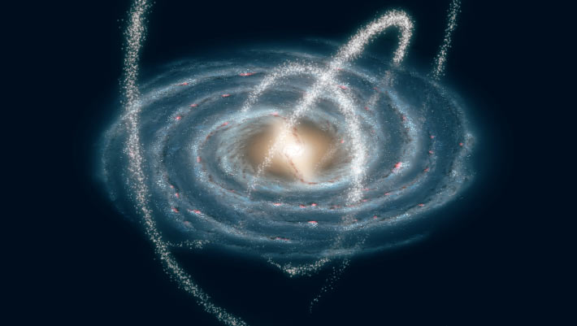
Part III: What Else can DES do?
A. Dwarf galaxies and streams of stars in the halo of the Milky Way Galaxy.
Image credit: NASA / JPL-Caltech / R. Hurt, SSC & Caltech.

Slide 2

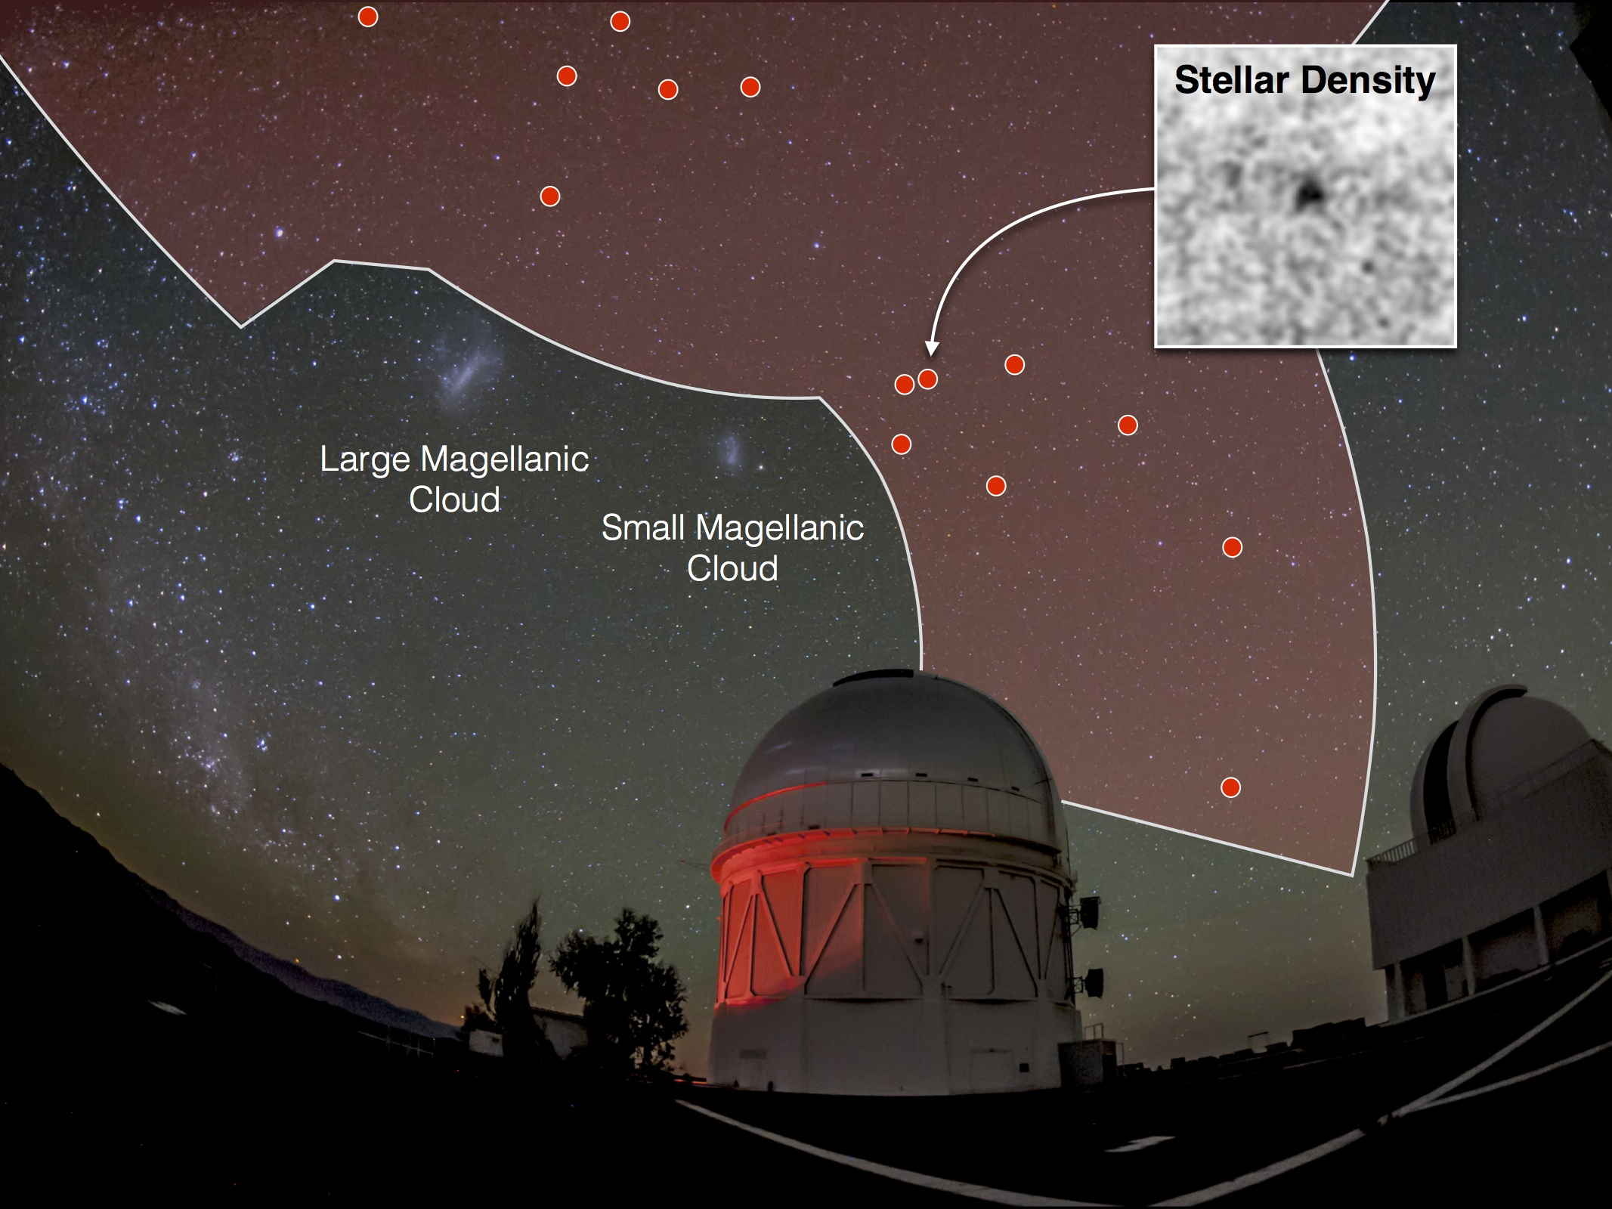
New Milky Way Dwarf Satellite Galaxies
17 New Milky Way Dwarf Satellites discovered by DES in first 2 years of data
Bechtol, et al, Drlica-Wagner, et al,
Koposov, et al

Slide 3
Milky Way Structure (regions of high star density)
Nora Shipp

Slide 4
Stellar Streams in Milky Way Halo (Nora Shipp et al. 2018)

Slide 5
Stellar Streams (Nora Shipp et al. 2018)

Slide 6
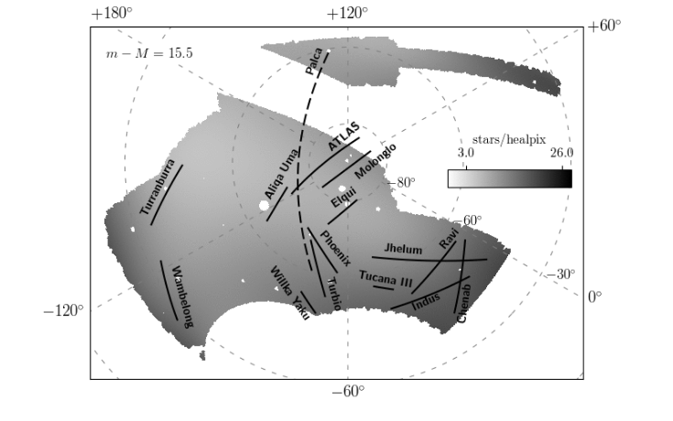
Stellar Streams (Nora Shipp et al. 2018)

